Slide 1
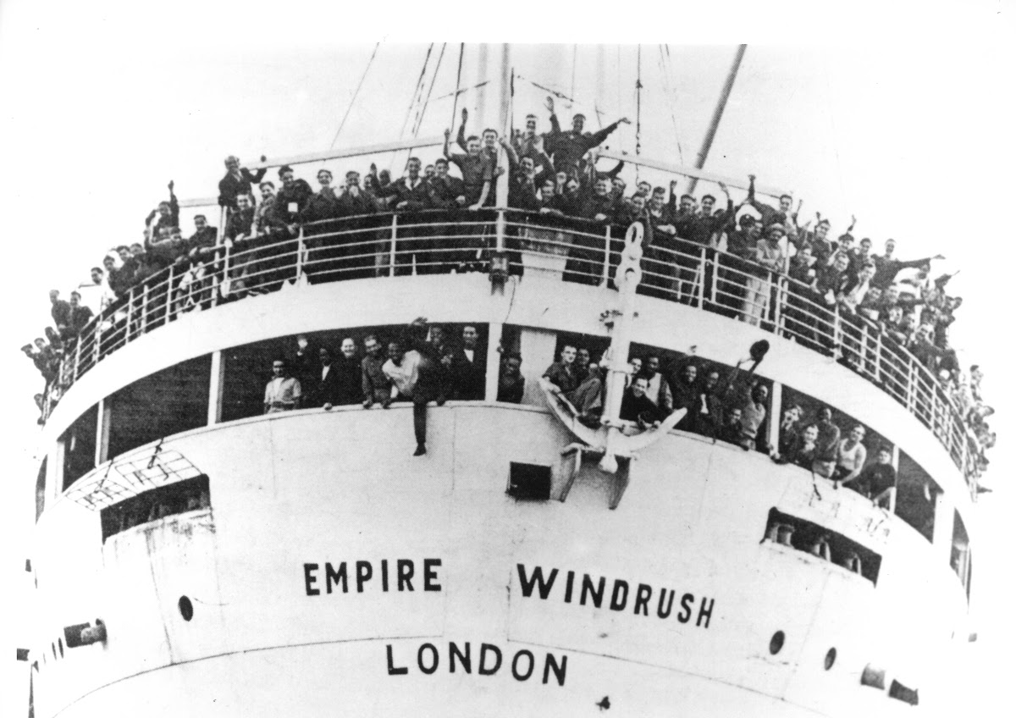
Windrush Generation

Slide 2
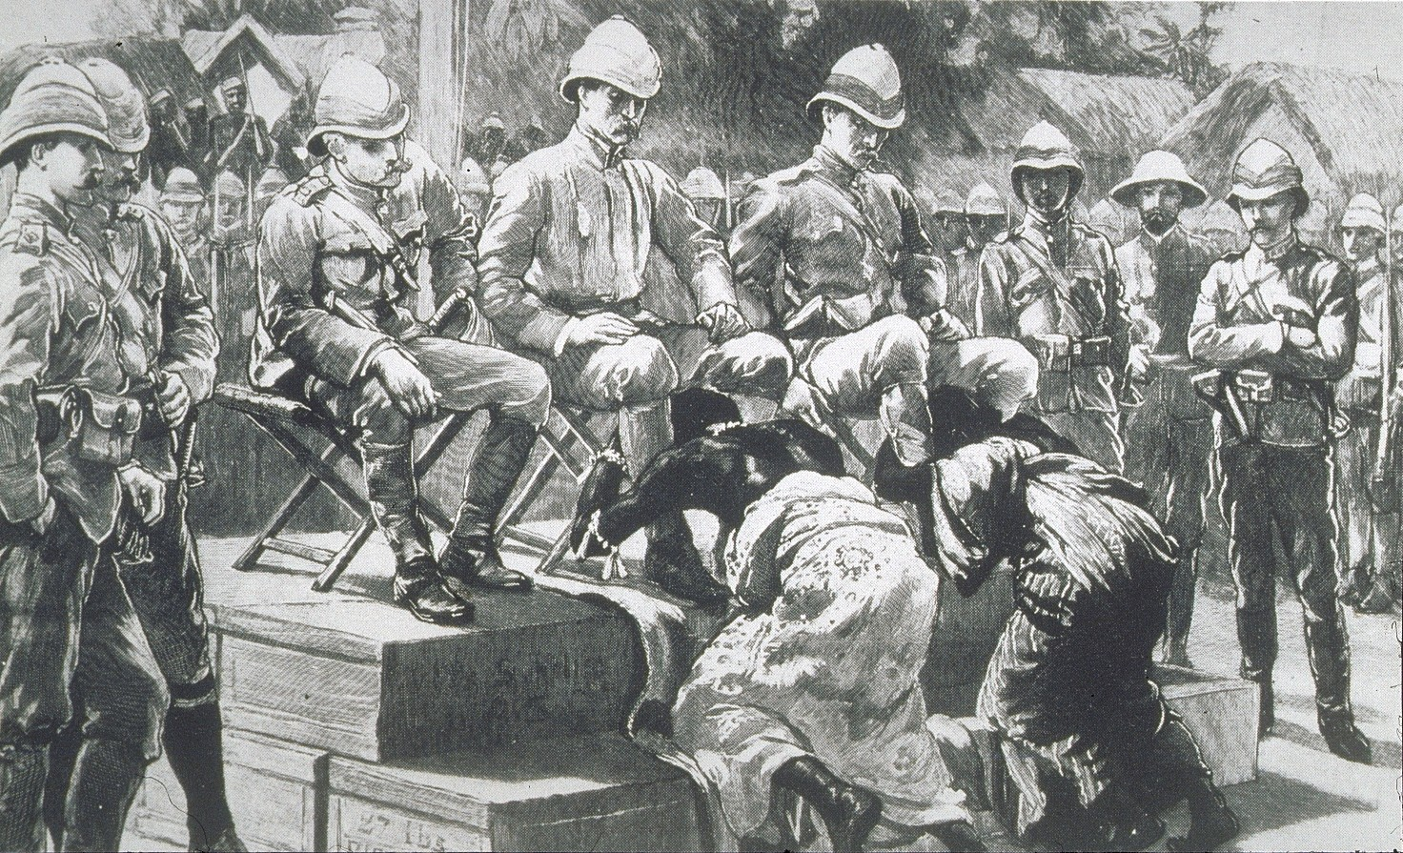
Europe and Colonisation
In the 15th century, Spain was the first to colonise the Caribbean. However this changed in the 17th century as more European countries joined Spain to gain control of parts of the Caribbean.
The Caribbean, also known as the West Indies, became one of the first of England’s overseas empire. Like many of the other European countries, England was in search of wealth. They began to grow sugarcane (a plant which went well with coffee, tea, chocolate and was also used to make rum!)
The rise of sugar plantations required more workers and planters/colonisers turned to buying enslaved men, women and children from Africa.
5 millions Africans were forcibly taken to the Caribbean, 2.3 million were brought to the British Caribbean. The population of the colony changed and Africans and their descendants formed the majority.

Slide 3
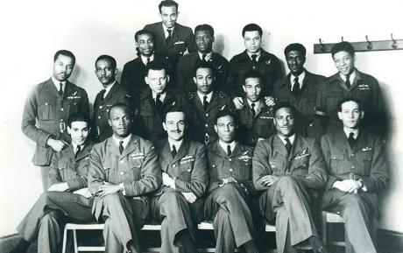
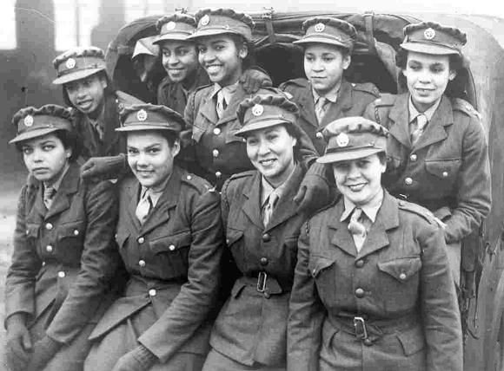
West Indians and WWII
More than 10,000 Caribbean men and women crossed the Atlantic to support in the Second World War . Although there was resentment of colonial rule, some felt it their patriotic duty to help the ‘Mother Country’.
Britain was reluctant to let black people join the war but relaxed their rules as the war progressed and the casualties of war began to rise.
Many West Indians were not allowed to serve on the front line. The RAF gained more recruits from the Caribbean than any other part of the British Empire, with around 400 flying as air crew and 6,000 working as ground staff. Many Caribbean women joined the Women’s Auxiliary Air Force.

Slide 4
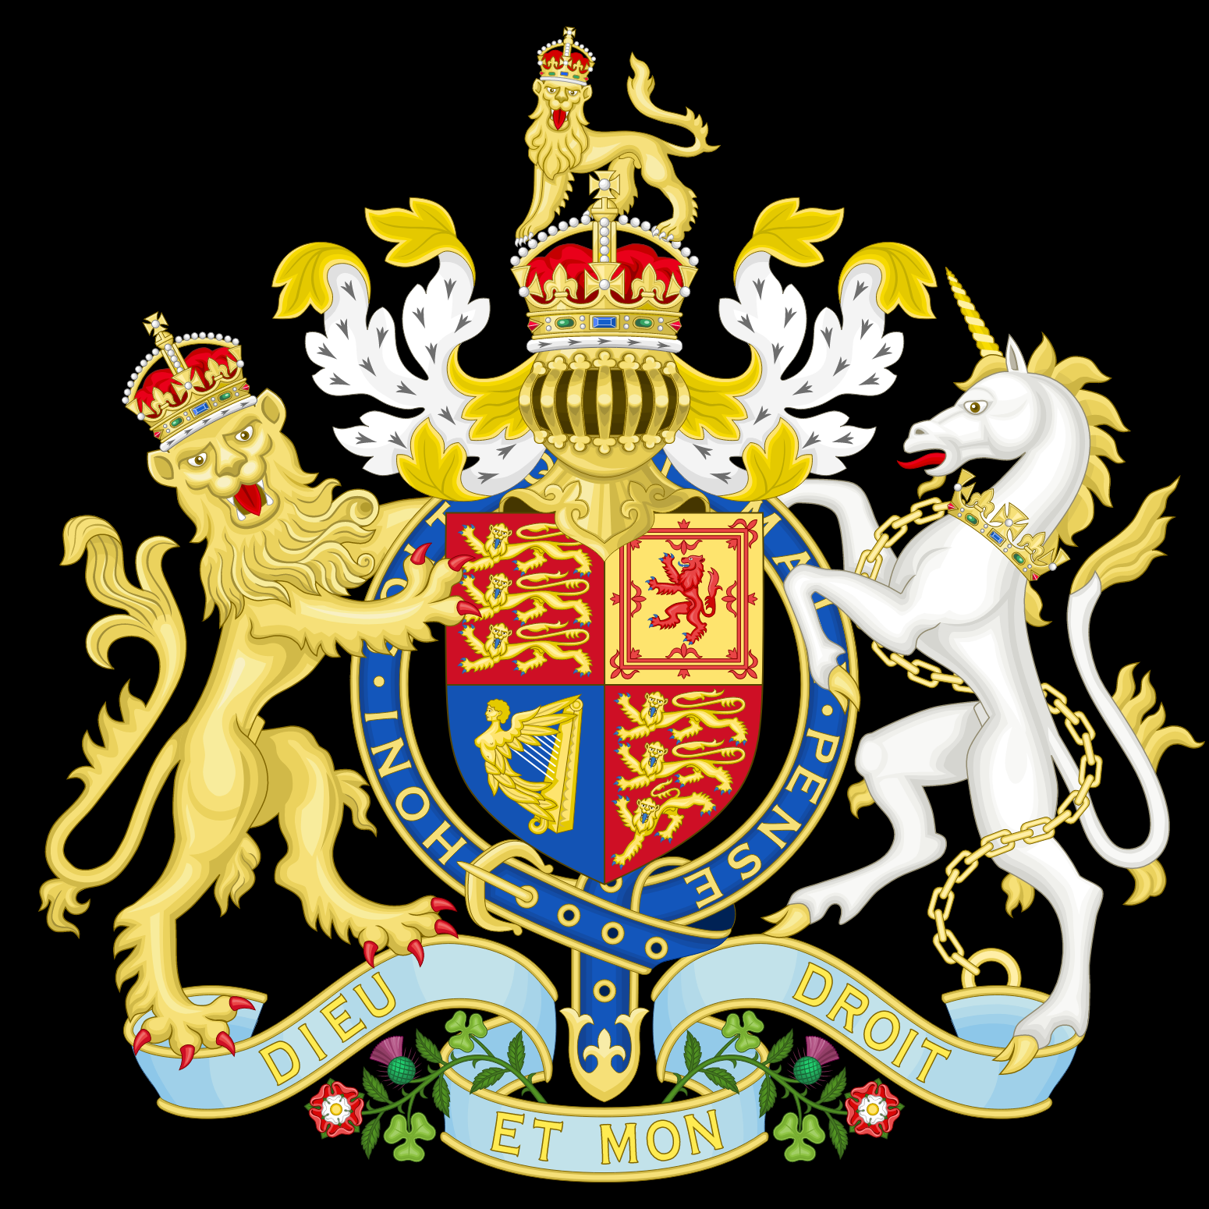
The British Nationality Act, 1948
After the Second World War, Britain needed help to rebuild. Many lives were lost during the war and buildings and homes were destroyed. Britain needed 1.3 million workers to help rebuild the country.
The 1948 British Nationality Act reaffirmed rights in common law, including the right for all British subjects within the Commonwealth to move freely and live anywhere they wished.
As employment was difficult in Caribbean islands like Jamaica after the war, some responded to Britain’s call for more workers to help tackle the labour shortage crisis in the UK.

Slide 5
What was the Windrush?
The Empire Windrush was a former German cruise liner and troopship commandeered to take servicemen back to the Caribbean.
On Thursday 27th May 1948, the Windrush set sail from Kingston to take some Caribbean people back to the UK. The ship disembarked at Tilbury on 22nd June 1948.

Slide 6
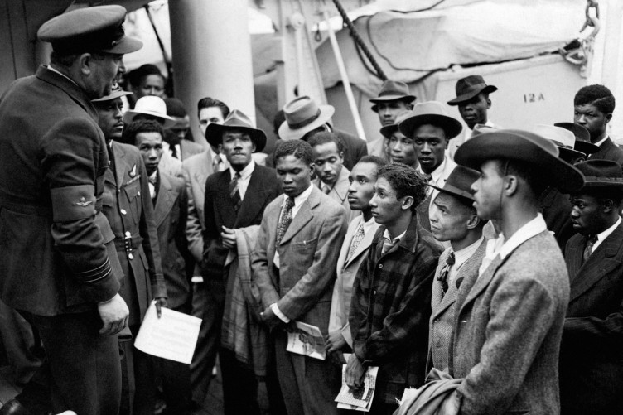
Reaction to the Windrush Generation
Before the Windrush even left Kingston, a telegram arrived from the British Governor’s Office in Jamaica to the Colonial Office in Whitehall delivering ‘bad news’
“I regret to inform you that more than 350 troop-deck passengers by EMPIRE WINDRUSH...have been booked by men who hope to find employment in the United Kingdom, and that it is likely that this number will be increased by another 100 before the vessel leaves. Most of them with no particular skills and few will have more than a few pounds on their arrival.”

Slide 7
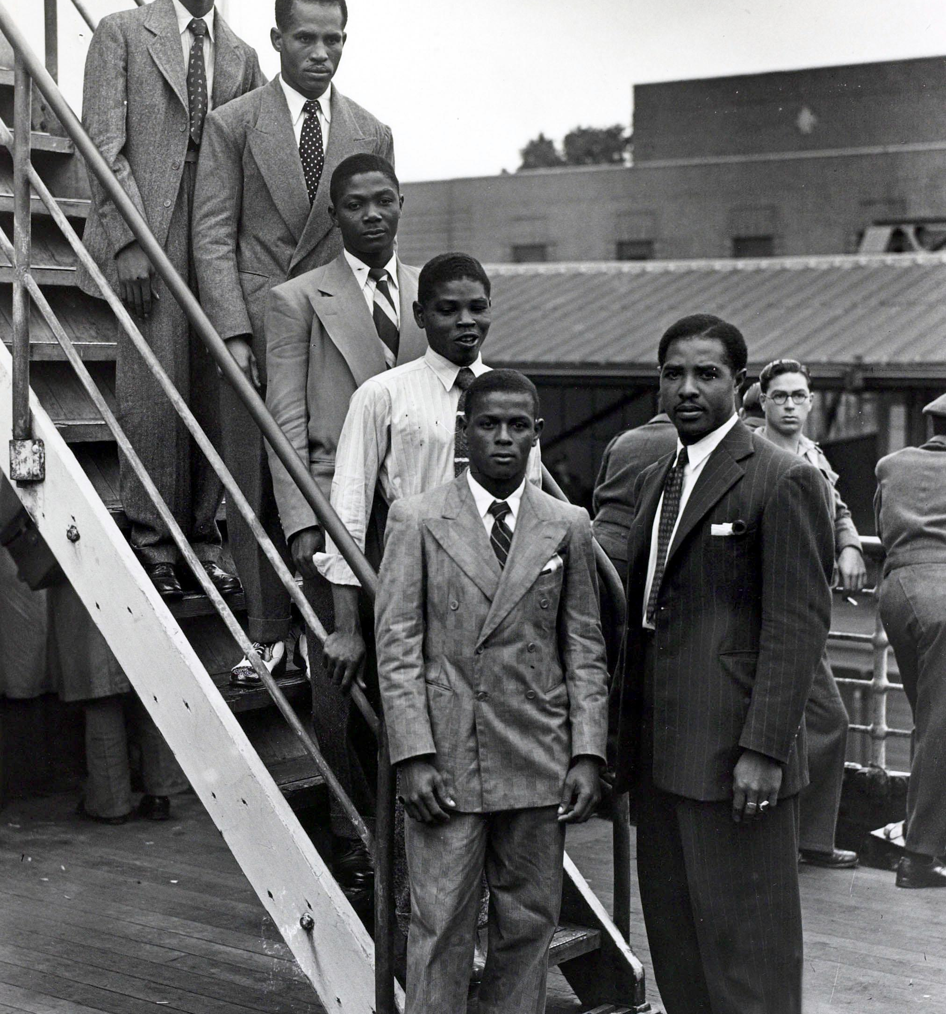
Passengers on the Empire Windrush
The British Governor’s Office in Jamaica suggested that most passengers ‘had no particular skills’. However, there were…
85 mechanics
54 carpenters
39 clerks
34 tailors
20 engineers
15 machinists
14 fitters
13 electricians
12 civil servants
3 boxers
A judge
Notes:
The ship was carrying 1,027 passengers, including two stowaways. Alongside those travelling from the Caribbean for work, there were also Polish nationals displaced by World War Two, members of the RAF and people from Britain. According to the ship's passenger lists, more than half of the 1,027 listed official passengers on board (539) gave their last country of residence as Jamaica, while 139 said Bermuda and 119 stated England. There were also people from Mexico, Scotland, Gibraltar, Burma and Wales. Overall, 802 passengers gave their last country of residence as somewhere in the Caribbean. Many of them had paid £28 (about £1,000 today) to travel to Britain in response to job adverts in local newspapers.
The majority of the people on board were men. There were 684 males over the age of 12, alongside 257 females of the same age. There were also 86 children aged 12 and under.
The listed occupations on the passenger lists give some indication of the wide range of skills that were on offer. Among those arriving from the Caribbean were mechanics, carpenters, tailors, engineers, welders and musicians. Also among the Caribbean passengers was a hatter, a retired judge, a potter, a barrister, two hairdressers, two actresses, two piano repairers, two missionaries, three boxers, five artists and six painters. The most noted occupation, though, was "HD" - or "housing domestic" - meaning a housewife, servant or cleaner. There were 172 overall on board - 96 from the Caribbean.

Slide 8
Notes:
In fact, almost half of all the men who came from the Caribbean to the UK throughout the 1950s had previously worked in skilled positions or possessed excellent employment credentials. However, many found their access restricted to jobs the local population considered undesirable, including street cleaning and general labouring, or to jobs that demanded anti-social hours such as working night shifts. Over half the men from the Caribbean initially accepted jobs with a lower status than their skills and experience qualified them for.

Slide 9
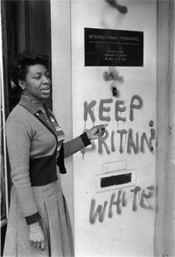
The Windrush Generation (1948-1971)
The Windrush generation was not welcomed in the UK. The government gave preference to white Europeans, some who fought against Britain in the war, over Caribbean veterans who fought for the ‘Mother Country’
The government assumed those who disembarked would stay temporarily
West Indians faced a hard time when arriving in England. Many people experience racism and found it difficult to find housing and employment
An economic boom in the 1950s required more workers so more people travelled from the Commonwealth to England to find work
Notes:
It was government policy to give preference to men who fought against Britain over men who were veterans and fought for England in the war, all because those veterans were black.
However, the initial reaction to Windrush was not welcoming. In the immediate post-war years, the government had recruited white Europeans, displaced during the war, to fill labour vacancies rather than looking to the Empire. And while some press headlines welcomed the Windrush passengers, the government was alarmed by the prospect of a visibly different population although reassured by the assumption that the several hundred men and some women who disembarked would be temporary visitors rather than ‘here to stay’.

Slide 10
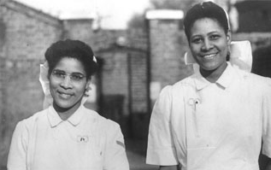
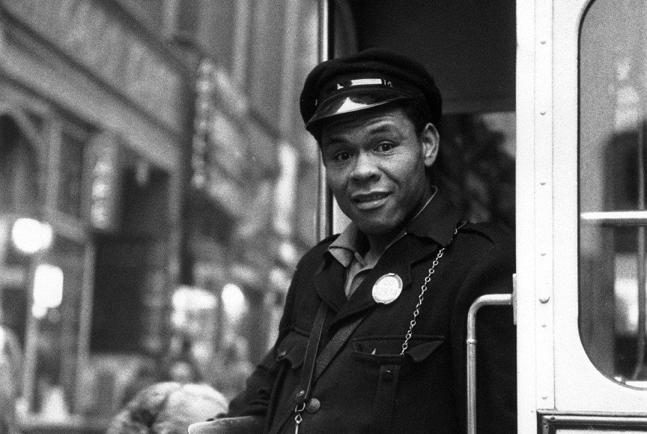
Windrush Generation’s Contribution to British Society
Most common sectors in which Caribbean people found jobs:
Manufacturing
Construction
Public transport
Post Office
NHS

Slide 11
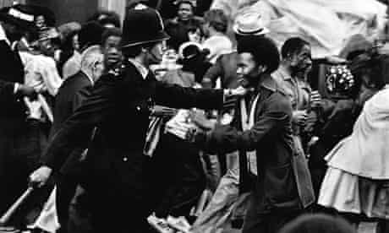
Notting Hill Riots
The Caribbean population grew to over 100,000 in London by 1961. Many settled in the Notting Hill area
There was competition for housing between poor white and black families and tensions grew
Tensions spilled over after an argument between an interracial couple. A white nationalist group known as the Teddy Boys witnessed this and hurled racial abuse at the woman because she was married to a black man
A 300-to 400-strong "Keep Britain White" mobs, many of them Teddy boys armed with iron bars, butcher's knives and weighted leather belts, went "hunting" for West Indians.
The riots lasted a week
The official insistence that the riots had not been racially motivation ensured a legacy of black mistrust of the Metropolitan police that has never really been eliminated.

Slide 12
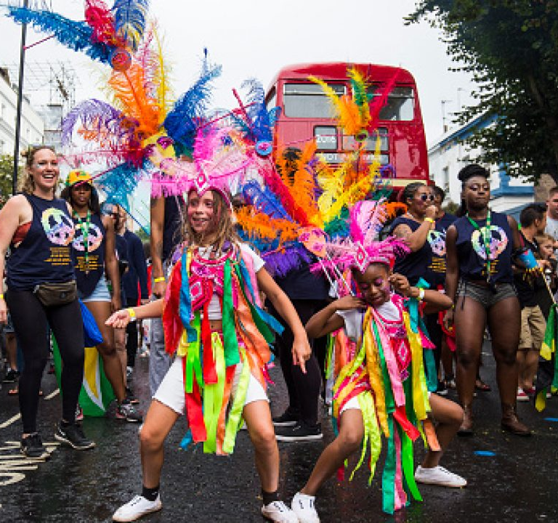
Notting Hill Carnival
The first ever London Caribbean carnival was organised by Claudia Jones (known as the Mother of Caribbean Carnivals in Britain)
She was part of a movement aimed at empowering cultural education and representation
She believed a carnival, a celebration of black freedom in the Caribbean, was a perfect way to ‘heal’ the tensions within Notting Hill
She held a yearly carnival until her death in 1964
Rhaune Laslett was influenced by Jones’ events and created the Notting Hill Carnival. It is now the largest street festival in Europe

Slide 13
Windrush Scandal
Changes in immigration laws meant some Commonwealth citizens who have lived in the UK from an early age had been threatened with removal from the country.
The Immigration Act of 1971 required any Commonwealth citizen who was questioned about their residency to prove that they were a legal citizen
Some citizens struggled to provide paperwork required by the Home Office to prove they could remain in the UK
It was discovered that the Home Office destroyed thousands of landing card slips recording Windrush immigrants’ arrival dates in the UK

Slide 14
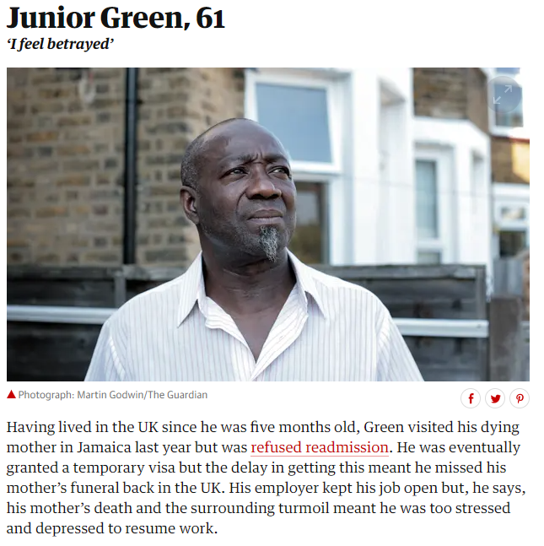
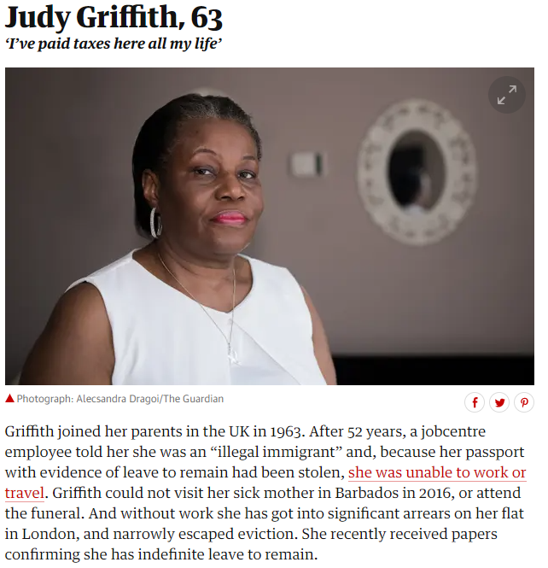
Children of the Windrush

Slide 15
In diversity there is beauty and there is strength
-Maya Angelou

Slide 16
Windrush Activities
Read the poem Call from the Motherland and answer the following question: How does the speaker express their thoughts and feelings about the motherland?
Imagine you are someone who was aboard the Windrush. Write THREE postcards to your family back in Jamaica. One postcard should be from when you just arrive in London, next postcard should be after 6 months in London; the final one should be after a year in London.
Write a description suggested by the picture

Slide 17
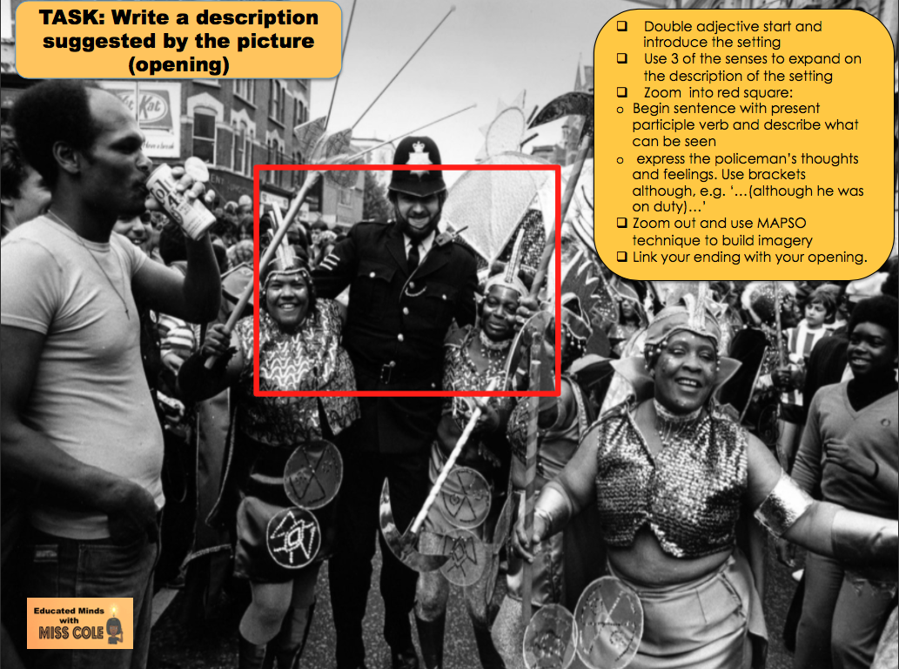
Notes:
Activity 3

Slide 18
Call of the Motherland
Come to England Come to England Come to the Motherland
A call to arms, a call to fight To give your substance and your might To serve the King and love the Queen You will be welcome – will be seen
Without question, without doubt We run to heed our mother’s shout
The country’s poor and broken down The call again, the clarion sound Calling workers from each isle To labour hard and stay a while
Without question, without doubt We run to heed our mother’s shout
Now the country’s been rebuilt By hard work and blood we spilt Our mother has no need of us
And claims our number is too much
Now we question, now we doubt Why does our mother want us out?
With borders closed and fear increased They say we drain and bring disease The call for us is to return Our loyalty and service spurned
She’s not our mother there’s no doubt She flushed us in to force us out
She lied when she said we are kin She loves the colour of our blood But hates the colour of our skin

